Slide 1
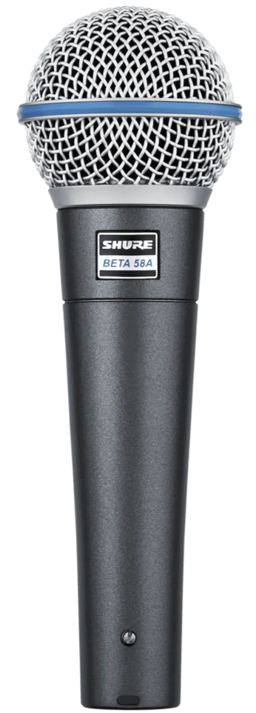
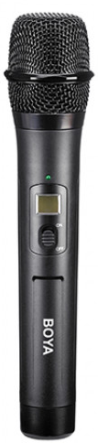
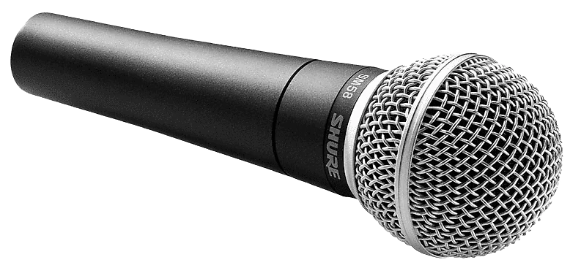
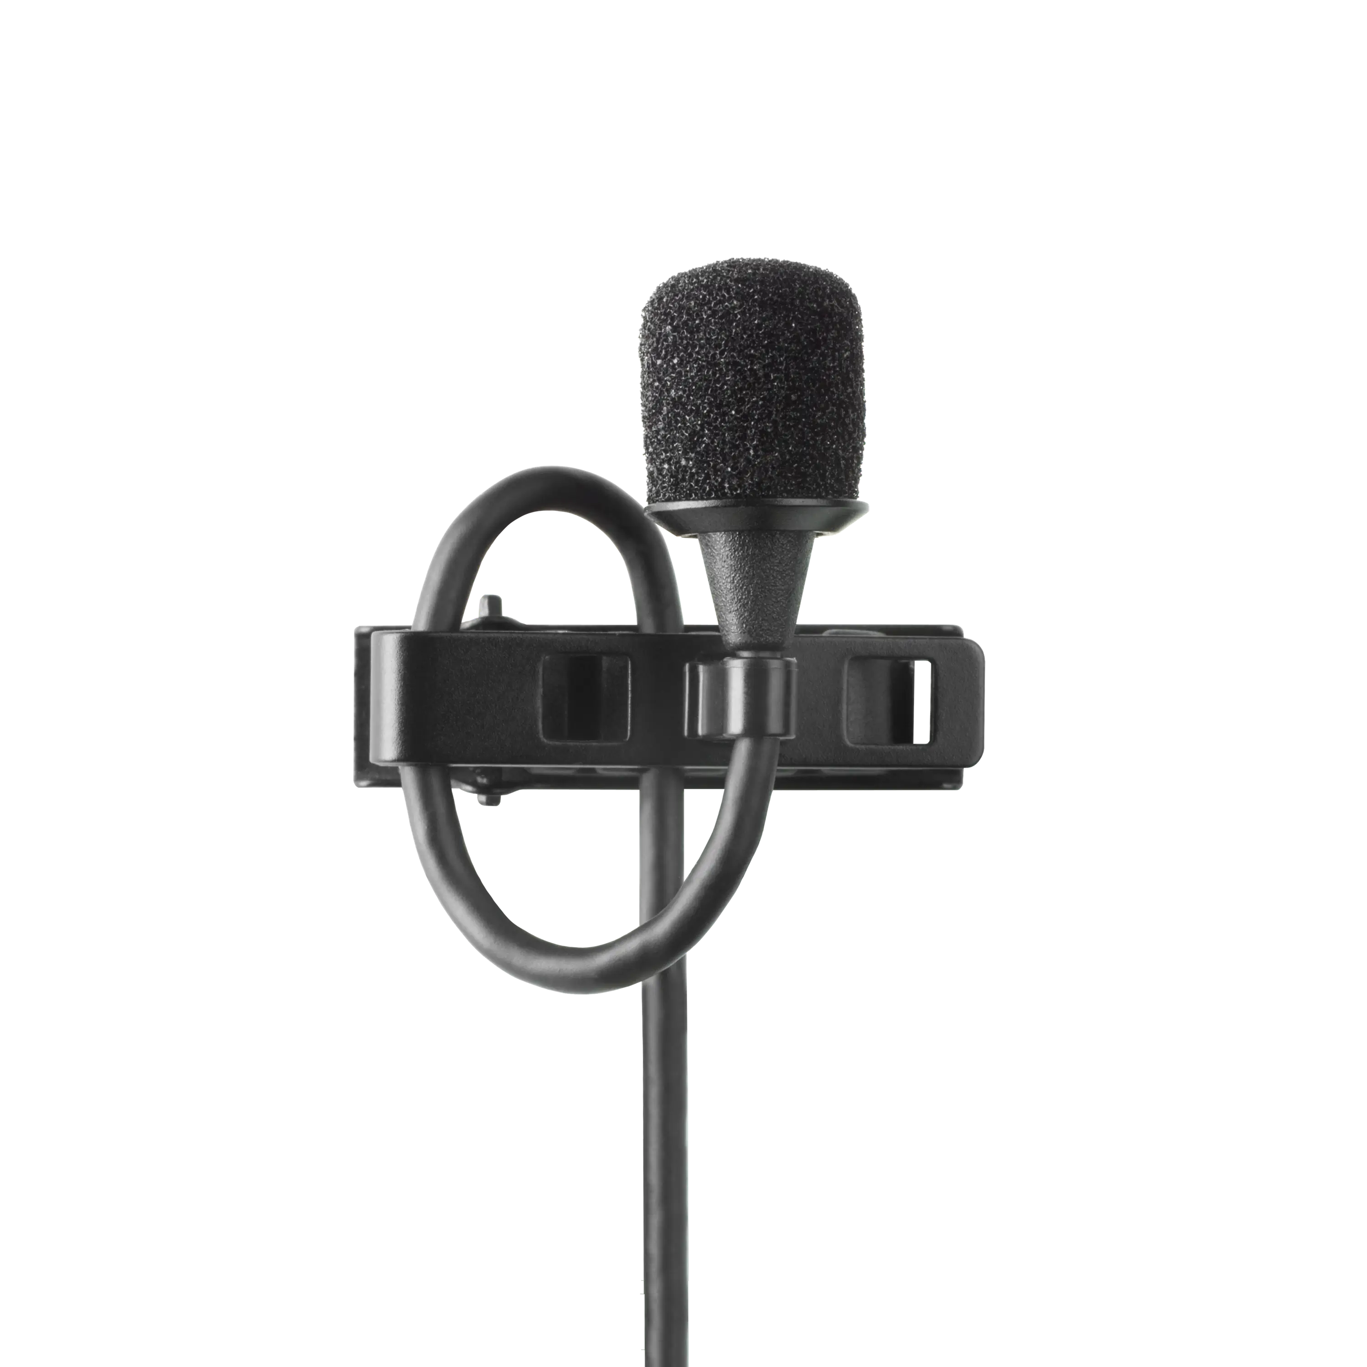
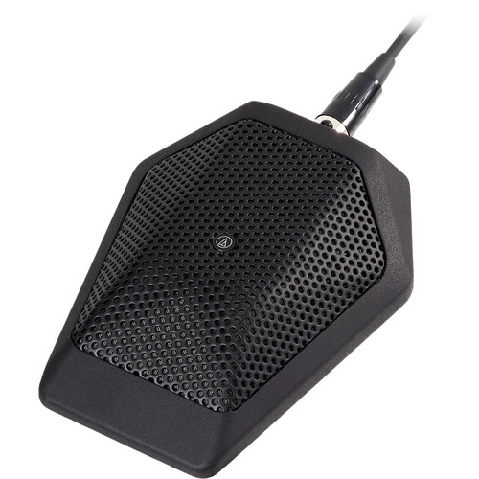
Identify the Microphone Construction Type
DYNAMIC MICROPHONE
CONDENSER MICROPHONE
SHOTGUN MICROPHONE
LAVALIER MICROPHONE
BOUNDARY MICROPHONE
NEXT SLIDE

Slide 2
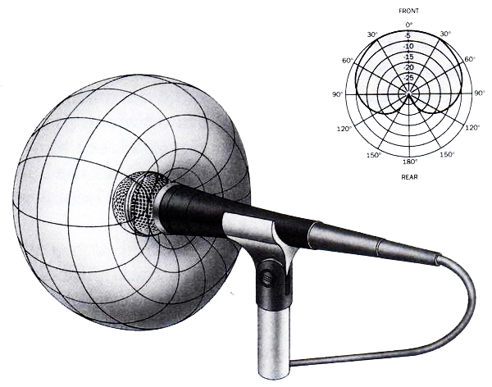
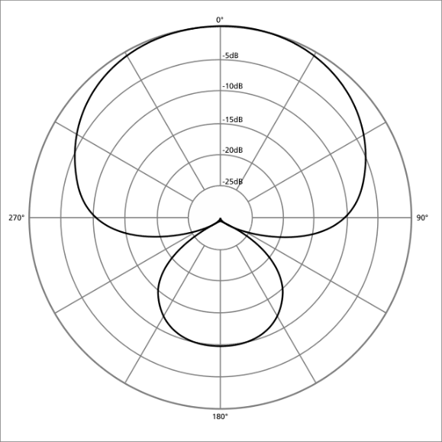
Identify the Microphone Construction Type
POLAR PATTERNS
DYNAMIC MICROPHONE
THE AREAS WHERE SOUND WILL BE BEST CAPTURED BY A GIVEN MICROPHONE
DOES NOT REQUIRE +48v
PHANTOM POWER
USUALLY SEEN IN STUDIO RECORDINGS FOR VOCALS
CONDENSER MICROPHONE
LAVALIER MICROPHONE
CARDIOID
TYPICALLY CONNECTS TO WIRELESS TRANSMITTER
THE MOST COMMONLY USED POLAR PATTERN THAT IS MOST SENSITIVE AT 0^{O} AND LEAST SENSISTIVE AT 180^{O}
END

