Slide 1
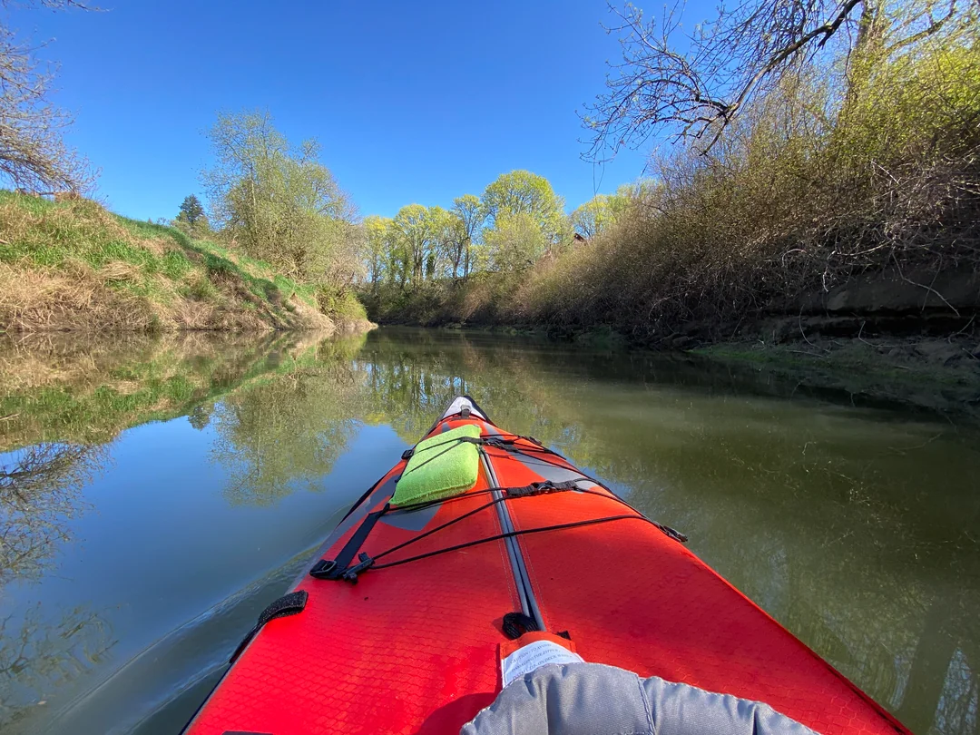
Going upstream
Today, we connect with our Value of Creativity: Courageous innovation.
Desmond Tutu, Anglican archbishop, once said:
“There comes a point when we need to stop pulling people out of the river. We need to go upstream and find out why they’re falling in.”
For reflection and discussion: Recall a time when your team looked deeper to find the root cause.
How did going to the source of the matter bring
about different solutions and creative outcomes?
Call to action: When facing challenges, listen for
the true need. Notice how a more informed response can transform a patient’s care and the health of our communities.
Prayer: God of bounty and abundance, fill us with the spirit of Creativity. As we bring new ideas that benefit the common good, may we encourage and honor others as they offer their diverse perspectives. With hopeful hearts, we pray. Amen.

