Slide 1
2026 Sector Webinar
28 May 2026

Slide 3

Webinar overview
  Our revised regulatory approach
  Insights into the 2025 Standards
  Practical tips on maintaining compliance with the 2025 Standards
  Principles for the responsible use of AI in VET
  Q & A

Slide 4
Ask us …
  We have received over 120 pre-submitted questions through the webinar registration process
  750+ questions through the workshops
  For today, use the live-stream ‘question’ function
Today’s slides and recording, along with the workshop slides, will be available on our website

Slide 5
Our revised regulatory approach

Slide 6
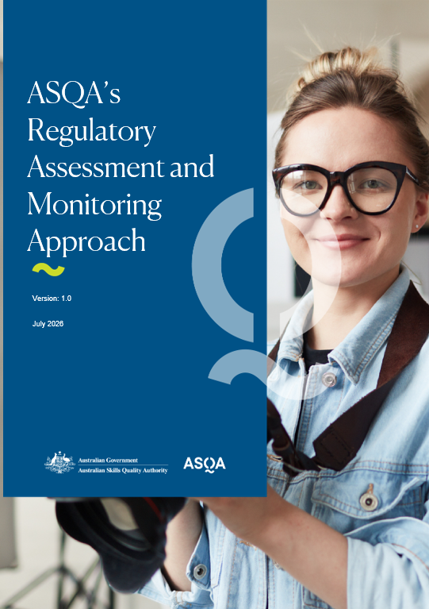
ASQA's
Regulatory Assessment and Monitoring Approach is coming...

Slide 7
Our revised assessment approach
Trigger
Plan
Notify you
Collect evidence
Analyse
Write report
Feedback
Make decision

Slide 8
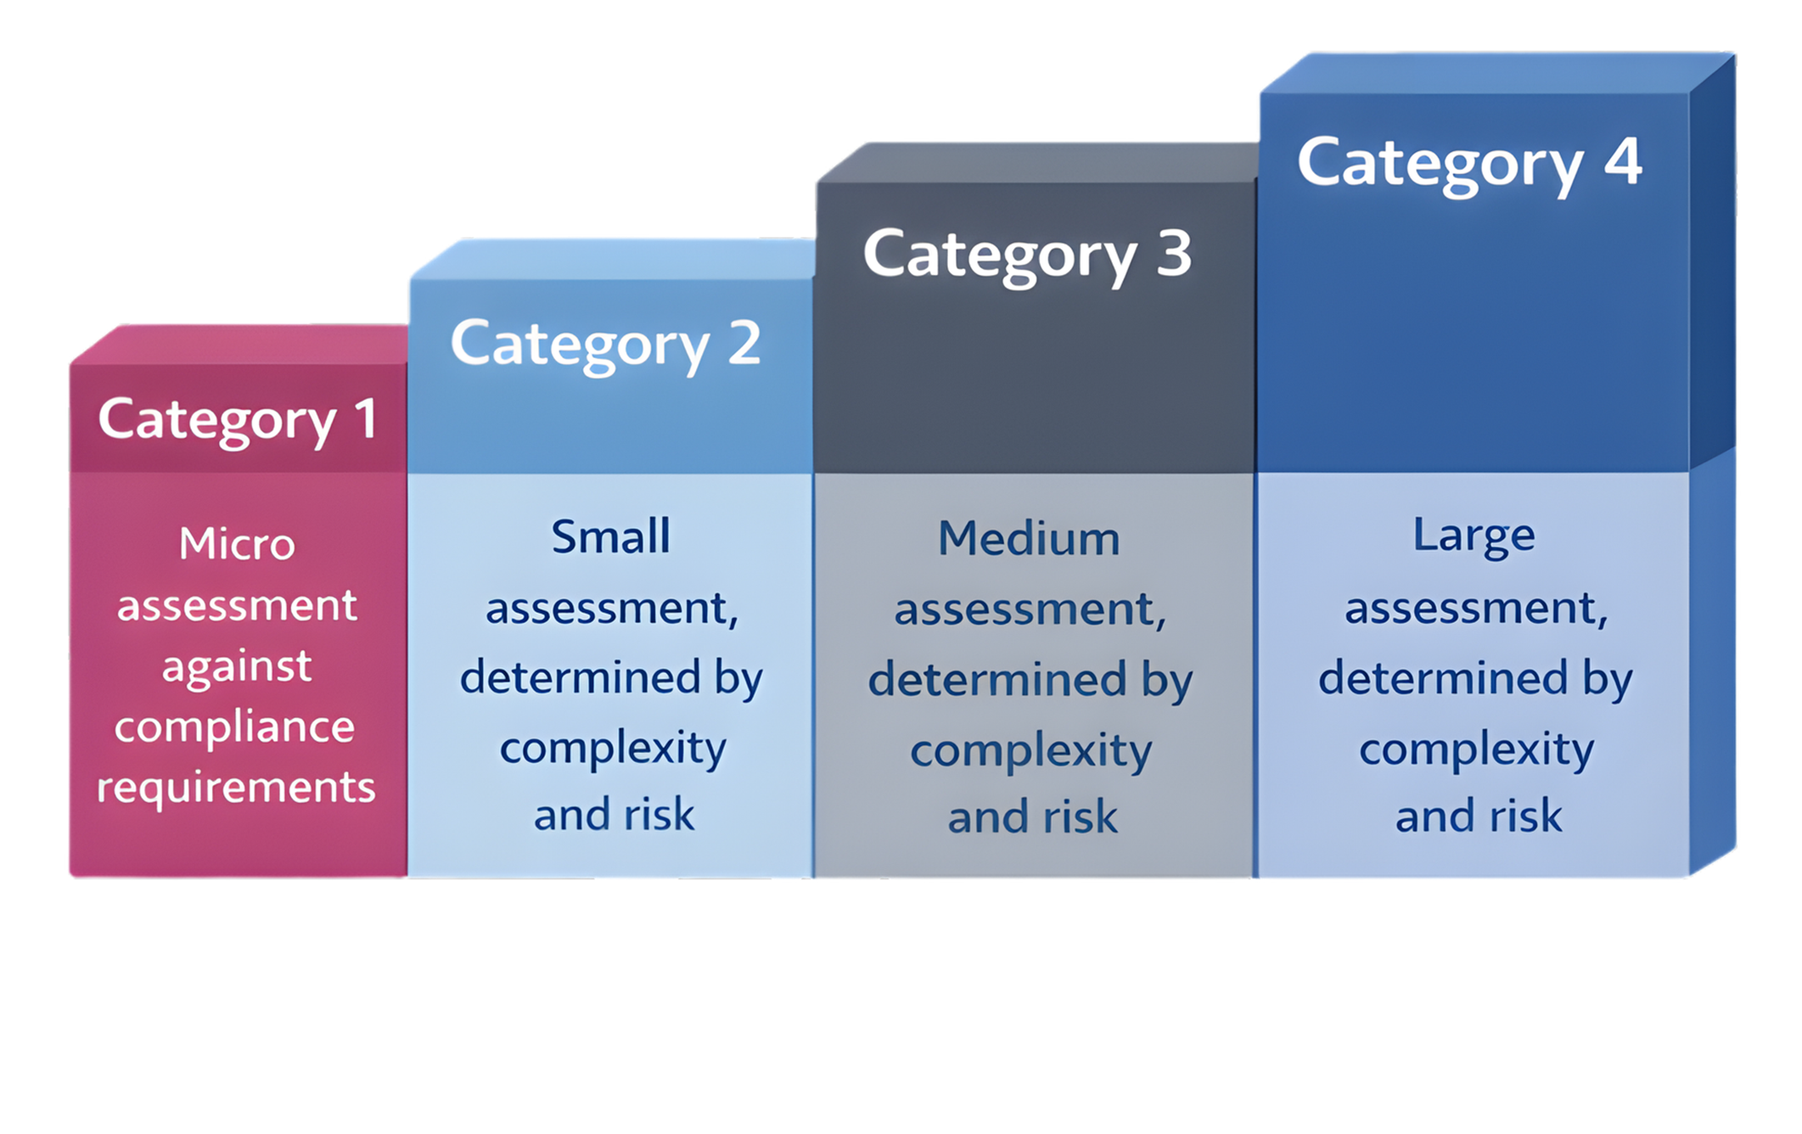
Performance assessments

Slide 9
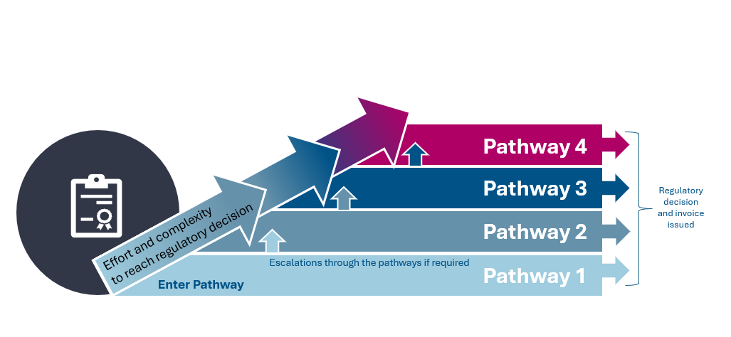
Compliance resolution

Slide 10
1 July changes and transition arrangements
  If activity commences:
  before 1 July – continue being charged under existing model
  from 1 July – charged under new model
Application and Assessment Fees
Performance assessments
Compliance Resolution
Activities underway pre‑July: will be completed under existing model
Activities starting from 1 July: new model applies commencing at Pathway 1, with progression as required
Applications: based on date of valid lodgement
Assessments: based on start date
Underway pre July: completed and charged under the existing model
Starting after 1 July: fixed category fees apply, with upfront cost and invoicing at completion

Slide 11
Your questions answered
Revised Regulatory Approach

Slide 12
Q1 – Will ASQA be publishing information on its revised regulatory approach?

Slide 13

Q&A
Q1 – Will ASQA be publishing information on its revised regulatory approach?
  Information will be published on the website in June 2026
  This will include the Cost Recovery Implementation Statement (CRIS) and a guide on our revised regulatory approach

Slide 14
Q2 – How will ASQA ensure transparency and fairness in the cost recovery model, particularly for performance assessments?

Slide 15
Q&A
Q2 – How will ASQA ensure transparency and fairness in the cost recovery model, particularly for performance assessments?
  Fixed fees and scaled assessment categories
  Performance Assessment (category) and cost will be indicated upfront

Slide 16
Q3 – Can providers review or question cost recovery decisions and invoices?

Slide 17
Q&A
Q3 – Can providers review or question cost recovery decisions and invoices?
  Invoices will reflect the charges outlined in the Fees and Charges Determinations, which will be published on the Federal Register of Legislation
  ASQA will provide information around fees upfront, with each application and activity type

Slide 18
2025 Standards Insights

Slide 19






What’s going well
1
Outcome Standard 2.6
The wellbeing needs of the VET student cohort are identified, and strategies are put in place to support these needs
2
Outcome Standard 2.3
VET students have access to support services, trainers and assessors and other staff to support their progress throughout the training product
3
Clause 7 Compliance Requirements
Guarantees and inducements
4
Outcome Standard 3.2 / Credential Policy
Training and assessment is delivered to VET students by credentialled people with current skills and knowledge in training and assessment.
4

Slide 20
Top 4 areas of concern
Poor quality assessment systems or practices
Poor quality training
Continuous improvement
Unsuitable or unqualified trainers and assessors

Slide 21

Poor quality assessment systems or practices
  Examples we are seeing:
  Unfair assessment systems and practice
  Assessment tasks, methods and tools not aligning to the required skills and knowledge
  Unreliable assessment methods

Slide 22



Poor quality assessment systems or practices
Context matters – Use tools tailored to your student cohort
Keep it clean – Don’t make adjustments that weaken assessment integrity
See it to assess it – Observe students on placement when required
Stay consistent – Ensure assessors apply assessment criteria the same way
Protect the process – Maintain strong systems to prevent & detect cheating
Your assessment system isn’t just the assessment tools – it also includes the policies, procedures and supporting documents that guide how assessment is conducted.
A mapping guide or matrix might assist in demonstrating how an assessment instrument meets all requirements of a unit of competency.
Mandated licence assessment tools alone may not fully meet the requirements of the unit of competency.
Reminder
Tip
Caution

Slide 23

Poor quality training
  Examples we are seeing:
  Training product requirements not being met
  Training is not appropriate for the student cohort
  Training does not reflect current industry practices
  Unsuitable training structure or pace

Slide 24
Poor quality training
Know your students – Design training that reflects the cohorts’ skills and needs
Don’t cut it short – Provide enough learning time to meet AQF expectations
Meet the industry mark – Align training with current industry need and practice
Get online delivery right – Only use online delivery where it genuinely achieves quality
Improve every round – Review cohorts and continuously strengthen training design
Although a document named a Training and Assessment Strategy is no longer mandated, your approach to training delivery and assessment must still be clearly documented.
There is no single formula to determine appropriate course duration. Professional judgement and a reasoned approach is what you need to show.
Take care to review purchased resources to ensure they cover all unit requirements and are properly contextualised to your cohort.
Reminder
Tip
Caution

Slide 25

Poor quality continuous improvement
  Examples we are seeing:
  Unsuitable monitoring and evaluation systems
  Inadequate monitoring and management of third parties
  Inadequate evidence of continuous improvement
  actions
  Not using feedback, complaints and appeals to
  inform continuous improvement

Slide 26
Poor quality continuous improvement
Know the rules – Understand your legislative and regulatory obligations, and how to apply them!
Make self-assurance a habit – Use systemised monitoring year-round, not just when ASQA is coming.
Capture & act – Document improvements and follow through
Improve everywhere – Look for continuous improvement opportunities across all parts of your operations
Hear every voice – Use multiple feedback channels and data sources
Update your self assurance tools when legislative changes occur.
Generic templates miss important details, so tailor your review processes to fit your operations.
Using only a single data set or feedback channel can give a false sense of security and narrow perspective.
Reminder
Tip
Caution

Slide 27

Unsuitable or unqualified trainers and assessors
  Examples we are seeing:
  Unsuitable or unqualified trainers and assessors
  Inadequate systems for verifying trainer and assessor competencies
  Lack of staff professional development
  Lack of adequate supervision for those
  working under direction

Slide 28
Unsuitable or unqualified trainers and assessors
Know your boundaries – Only deliver and assess units when you hold the right industry competencies, skills and knowledge
Keep skills fresh – Stay up to date with current industry practices – no outdated training!
Review competencies regularly – Reassess trainer and assessor competencies beyond onboarding to ensure ongoing relevance.
Do your due diligence on industry experts – Check industry experts are suitable, work alongside qualified trainers, and record their involvement.
Professional development applies to trainers and assessors employed or contracted by the organisation and those engaged by a third party.
A matrix is one way to map trainer / assessor competencies against training product requirements. Back this up with evidence like resumes, qualifications and PD record.
Industry currency varies by sector – fast changing fields like IT require more frequent engagement than traditional areas like marriage celebrancy.
Reminder
Tip
Caution

Slide 29
Artificial Intelligence (AI)
Understanding the responsible use of AI

Slide 30
What is Artificial Intelligence (AI)?
  AI
  Field of computer science that creates systems capable of performing tasks that normally require human intelligence.
  Generative AI
  A type of AI that can create new content based on patterns it has learned from large amounts of existing information.
AI
Generative AI

Slide 31
Risks
Opportunities
  Data privacy, security and transparency
  Bias, accuracy and content quality
  Academic integrity and assessment risks
  Capability, cost and technology‑reliance challenges
vs
  Administrative efficiency and workflow improvements
  Curriculum, content and teaching enhancement
  Accessibility, inclusivity and student support
  Innovation i.e. immersive and engaging learning experiences

Slide 32
Examples of poor AI provider use or governance
Submitting Annual Declaration on Compliance responses that still contain visible AI prompts or drafting notes
Being unprepared for students using AI tools inappropriately or to cheat
Using AI to write up responses to address non-compliance that aren't contextualised to provider operations

Slide 33
Principle 1
AI use is supported by strong governance that ensures it does not undermine the quality or integrity of VET
Description
AI used in ways that protect the quality and integrity of VET through strong organisational governance, transparent processes and robust controls that ensure AI-enabled practices remain compliant and reliable.
DRAFT
Most relevant quality area / Standards / Clause
Quality Area 4 - Governance (Standard 4.1)
Compliance Requirements - Clause 9

Slide 34
Human oversight and accountability is maintained in all AI‑supported activities, ensuring that decisions affecting students remain the responsibility of qualified trainers, assessors and staff.
Principle 2
Description
AI is used in ways that ensure qualified trainers, assessors and staff retain full responsibility for decisions, applying active human oversight and professional judgement to AI‑supported activities.
DRAFT
Most relevant quality areas / Standards
Quality Area 1 - Training and assessment (Standard 1.4)
Quality Area 3 - VET workforce (Standards 3.2 and 3.3)
Quality Area 4 - Governance (Standard 4.2)

Slide 35
Principle 3
AI systems and tools manage information securely and in accordance with existing privacy, data protection and record keeping obligations.
DRAFT
Description
AI is used lawfully and in accordance with privacy, security and data‑handling obligations across all aspects of training delivery and support.
Most relevant quality area / Standards / Clause
Quality Area 4 - Governance (Standards 4.1 and 4.3)
Compliance Requirements - Clause 20

Slide 36
Principle 4
AI use supports and enhances student equity, inclusivity, accessibility and wellbeing.
Description
AI supports and enhances equitable, inclusive and accessible learning experiences for all students, including those with diverse backgrounds, abilities, digital literacy levels and support needs.
DRAFT
Most relevant quality area / Standards
Quality Area 2 – VET student support (Standards 2.2-2.6)

Slide 37
Principle 5
AI use aligns with training product requirements, industry expectations and the needs of the relevant student cohort.
DRAFT
Description
AI is used deliberately and with clear purpose, strengthening the quality, integrity and industry relevance of VET delivery across training, assessment and student cohort.
Most relevant quality area / Standards
Quality Area 1 - Training and Assessment (Standards 1.1, 1.2 and 1.3)
Quality Area 2 - VET student support (Standard 2.2)

Slide 38
Your questions answered
AI

Slide 39
Q1 – What are RTOs’ responsibilities for AI governance frameworks?

Slide 40
Q1 – What are RTOs’ responsibilities for AI governance frameworks?
Q&A
  AI must be governed well
  If you’re using AI, integrate it purposefully into your existing systems, policies and controls
  Remember that the AI Principles map to the Standards

Slide 41
Q2 – What capability do trainers / assessors need to manage AI in the classroom?

Slide 42
Q2 – What capability do trainers/assessors need to manage AI in the classroom?
Q&A
  Understand AI capabilities, limitations and bias
  Maintain academic integrity
  Apply professional judgement and ethics – what are your trainers and assessors allowed to use AI for, and what are they not allowed to use it for?
    Remember that AI must not make assessment judgements!
  Support students to use AI responsibly and set expectations for AI use
  Engage in ongoing professional development

Slide 43
Q3 – Does ASQA have internal AI policies and what are the potential impacts on RTOs?

Slide 44
Q3 – Does ASQA have internal AI policies and what are the potential impacts on RTOs?
Q&A
  AI Transparency Statement
      AI use lifts quality and effectiveness
      Focuses on ethics, safety and public trust
  All decisions and regulatory actions are made by humans

Slide 45
Your questions answered
General

Slide 46
Q1 – When can we expect to be audited? Is it only on renewal?

Slide 47
Q1 – When can we expect to be audited? Is it only on renewal?
Q&A
  Can occur at any time, not just renewal
  Risk-based
    Triggers can include time since last performance assessment, regulatory risk priorities, complaints/tip-offs, data, compliance history, organisational changes
  May or may not include site visits (which can be announced or unannounced)

Slide 48
Q2 – How is ASQA monitoring third party providers?

Slide 49
Q&A
Q2 – How is ASQA monitoring third party providers?
  RTOs are responsible and accountable for their third parties
  RTOs must report all third party arrangements to ASQA
  If you have third party arrangements, you must have capacity to monitor their compliance

Slide 50
Q3 –With the removal of the validation cycle under the 2025 Standards, how does ASQA define a “sufficient” approach to validation?

Slide 51
Q3 – With the removal of the validation cycle under the 2025 Standards, how does ASQA define a “sufficient” approach to validation?
Q&A
  No prescribed schedule – you need to decide what is sufficient for your context
  Focus on outcomes – demonstrate assessment is valid, consistent and adequate
  Provide clear evidence – show what was reviewed, why, and how improvements were made

Slide 52
Q4 – When should a ‘compliance risk’ be reported as a material change versus as non‑compliance in the Annual Declaration on Compliance?

Slide 53
Q4– When should a ‘compliance risk’ be reported as a material change versus as non‑compliance in the Annual Declaration on Compliance?
Q&A
  Material change = immediate notification
  Significant event or risk affecting ability to comply
  Reported as soon as identified
  Includes emerging or systemic compliance risks
  Annual Declaration = retrospective disclosure
  Covers previous 12 months
  Discloses identified non-compliance and actions taken
  Reflects effectiveness of self-assurance systems

Slide 54
Q5 – How should RTOs manage privacy and confidentiality during practical assessments, such as in disability training?

Slide 55
Q5 – How should RTOs manage privacy and confidentiality during practical assessments in Disability training?
Q&A
  Obtain informed consent (as per privacy laws and your organisational policies/procedures)
  Ensure clients, students or participants understand how their information will be used, recorded and stored before assessments begin
  Maintain confidentiality, avoid unnecessary disclosure and protect client wellbeing

Slide 56
Q6 – How can an RTO demonstrate, through its documentation evidence, that it is meeting the Outcome Standards, particularly in showing that students are achieving high-quality outcomes?

Slide 57
Q6 – How can an RTO demonstrate, through its documentation evidence, that it is meeting the Outcome Standards, particularly in showing that students are achieving high-quality outcomes?
Q&A
  Evidence = by-product of everyday practice and not created just for the regulator
  Consider:
      Assessment consistency
      Student outcomes
      Feedback & opportunities for improvement
      Risks & responses
  Evidence should show outcomes, not just process

Slide 58
Live questions

Slide 59

In case you missed it…
Additional resources www.asqa.gov.au
  Statement of Regulatory Expectations
  Response to antisemitism
  ESOS suspension on initial registrations and add to scope

Slide 60

Your feedback matters
https://surveys.asqa.gov.au/n/9Y1t5x9

