Slide 1
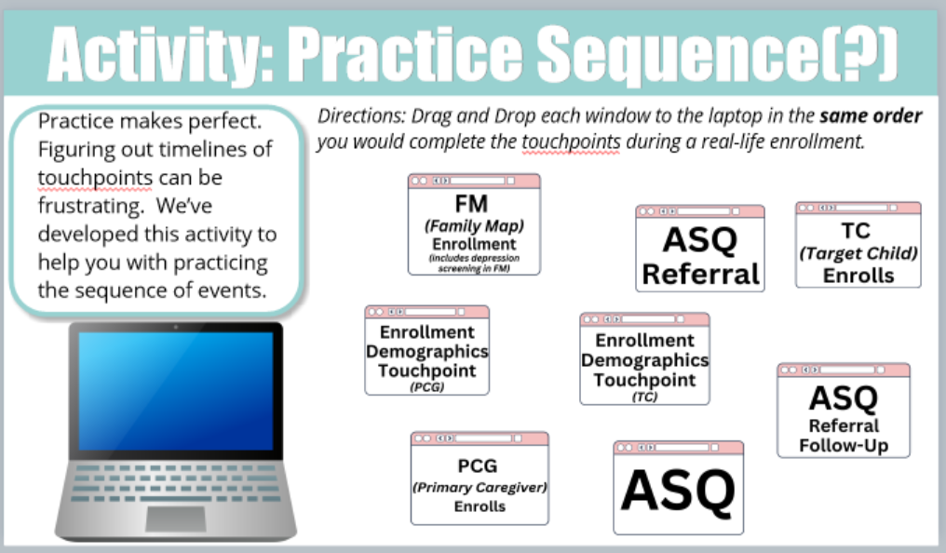
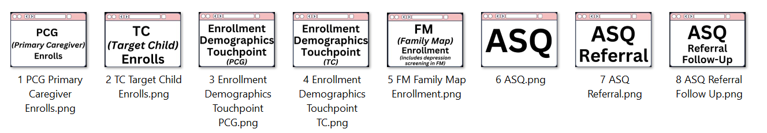
Please add your notes/feedback here and send back to me (I need you to verify (or provide the correct version) ALL of the verbiage/terminology, titles, directions, description, window screens (touchpoints?))
Please add your notes/feedback here and send back to me
This is the order of the window drag sequence

Slide 2
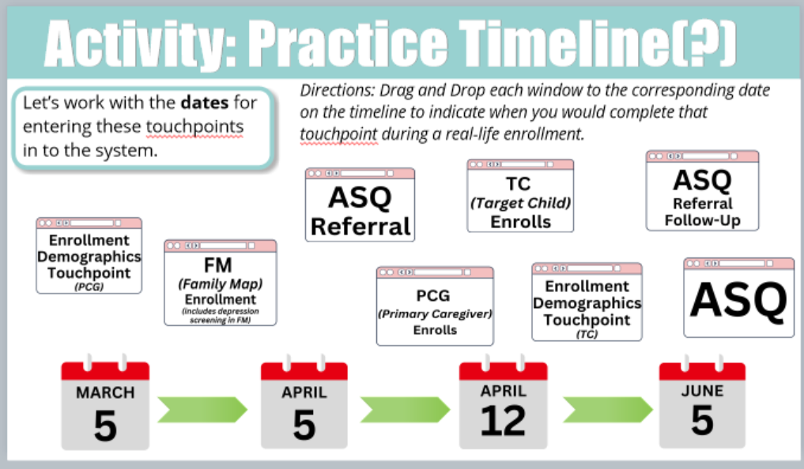
Please add your notes/feedback here and send back to me (I need you to verify (or provide the correct version) ALL of the verbiage/terminology, titles, directions, description, window screens (touchpoints?), and calendar dates)

Slide 3
These are the dates I’m using for each window (touchpoint):
1PCG (Primary Caregiver) Enrolls –1 Facilitator Says: PCG enrolls 7/5, please place this on the timeline where you think it goes. (It goes on July 5th) (It goes on Mar 5th)
2TC (Target Child) Enrolls – 2 Facilitator Says: Please place this where you think it should go on the timeline. (It goes on July 5th) (It goes on Mar 5th)
3Enrollment Demographics TP (PCG) – 3 Facilitator Says: This is for the enrollment Demographics on the PCG please place it where you think it should go on the timeline. (It goes on July 5th) (It goes on Mar 5th)
4Enrollment Demographics TP (TC) – 4 Facilitator Says: This is for the enrollment Demographics on the TC please place it where you think it should go on the timeline. (It goes on July 5th) (It goes on Mar 5th)
5FM (Family Map) Enrollment –5 Facilitator Says: Place this where you think the enrollment FM for TC1 should go on the timeline. (Within the first 30 days of Enrollment) (It goes on Apr 5th) (includes depression screening in FM)
6ASQ – Facilitator Says: 6 This is for the enrollment ASQ please place it where you think it should go on the timeline. (Within the first 30 days of Enrollment) (It goes on Apr 5th)
7ASQ Referral – 7 Facilitator Says: Based on the ASQ we just did we need to make a referral. What type of referral can we make? (Within 7 days of screening) (It goes on Apr 12th)
  Facilitator Says: What 2 type of referral can be made?
  First Connections (ages 0-3) or Co-op (ages 3-5)
  Center-Based Referral (ages 0-5)
8ASQ Referral Follow-up – 8 Facilitator Says: This is the Referral Follow-up for your ASQ referral. Where should it go on the timeline? It goes on June 5th)
  First Connections – must be evaluated within 45 days from REFERRAL
  Co-op – must be receiving services within 60 school days from REFERRAL
  Center-Based – must be receiving services within 30 days from REFERRAL

